Slide 1
Netværks event med products

Slide 2
Agenda
Welcome + Introduction (5mins)
Met Products: (10 mins)
AI - Presentation 10 mins
Break (5mins)
Workshop (45mins)
Networking

Slide 3
Mød teamet bag dine skærme
Hvem vi er, hvad der motiverer os, og hvorfor din hverdag er vores mission.

Slide 4
Velkomst &
hvem er i rummet
I bruger 8 timer om dagen på at arbejde i e-conomic. Vi bruger 8 timer om dagen på at bygge det.

Slide 5
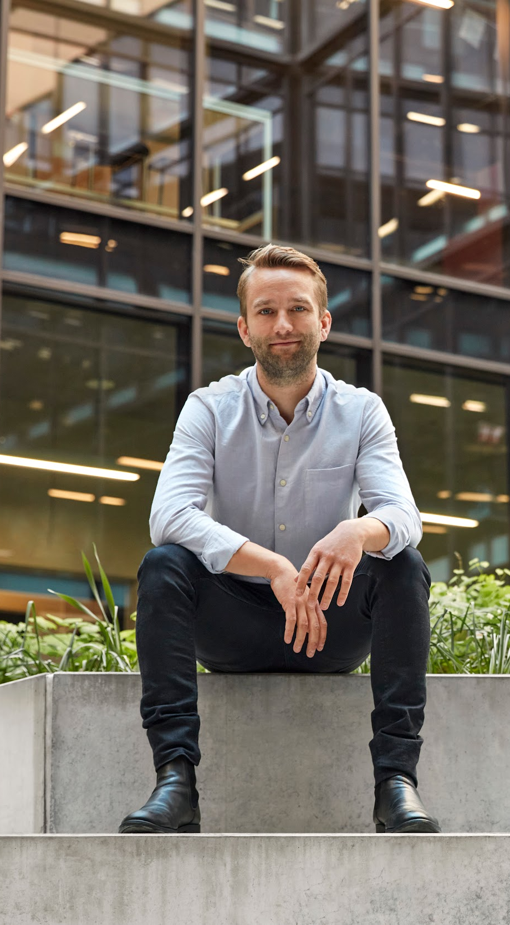
Our Vision
To transform the future of accounting with the customer at heart
Our Mission
To offer the most innovative accounting technology that simplifies workflows, ensures compliance and increases business efficiency

Slide 7
Fun Facts
210 people in products
Working in 7 countries
38 nationalities

Slide 8
2025: Vi kunne ikke holde op med at snakke med jer 🎉
· 600+ interviews
· 20 workshops
· 55 gange ude af kontoret
·Roadshow

Slide 10
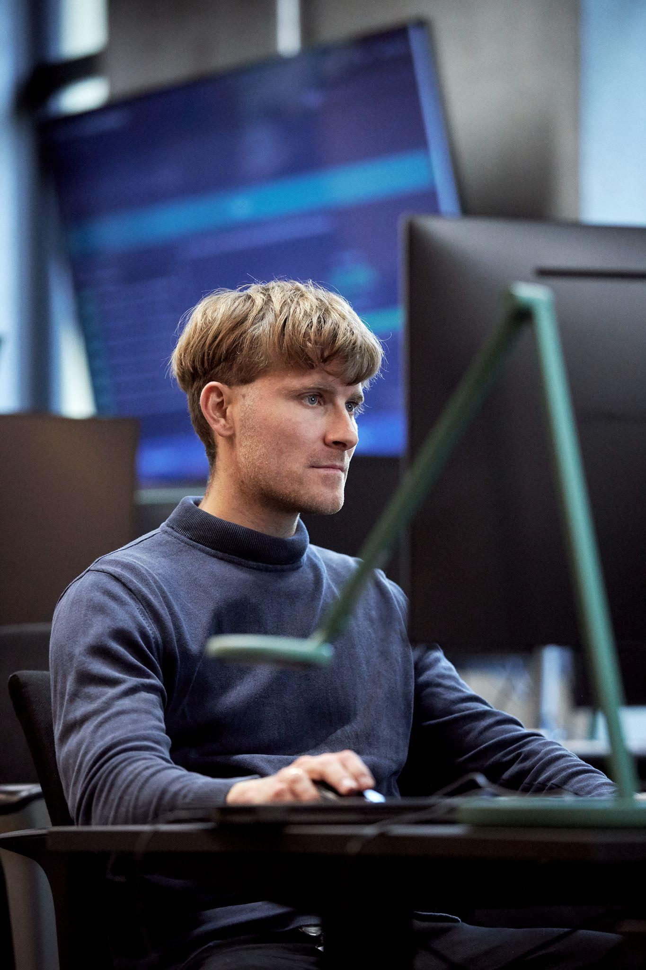

Slide 11
Why it’s important to us

Slide 12
We reach out
co-create
You book when it fits your schedule
Sign up for the user panel
20 min talk, or a longer 45 mins
Early access
Test a product

Slide 13
What does a user touchpoint look like.
Meet a designer and a product manager, maybe a developer is listening in For example you might meet: Emma + Kasper
We talk about who you are, how you work, what is important to understand your working context
We might dive into your needs, pain points, or wishes.
Additionally we might test a new prototype try it out. There are no right or wrong answers.
We might talk about your workflows, how long it takes, do you have any hacks or work arounds.

Slide 14
Where we are going?

Slide 15
AI

Slide 16
Workshop

Slide 17
Thanks

